Slide 1

Math Analysis
By Francisco Salazar b4

Slide 2

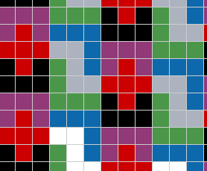
01_Patterns
A simple pattern that actually took some time to figure out
The pentominoes can be clearly seen and were hard to pick out

Slide 3
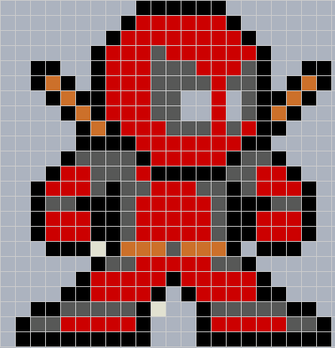
02_Pixel Art
Compared to original picture, it was kind of easy to count out the blocks
It was just a matter of placing the picture and trying to center it

Slide 4
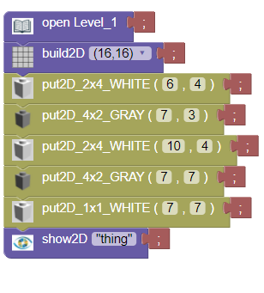
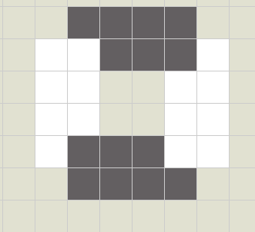
04_Objects in Bricklayer-Lite
Level 1 code was pretty basic and didn’t take much time
Only problem was the nitpicky aspect of leaving 1 shape under the other

Slide 5
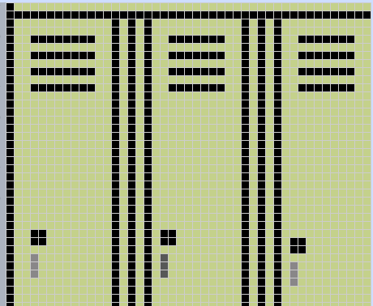
05_Objects around Bryan in Bricklayer-Lite
The lockers were created in the grid due to computer problems
The spacing was hard to figure out, so I had to guess on a good chunk of it.

Slide 6
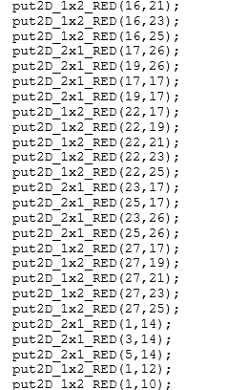
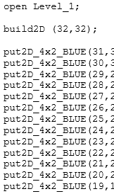
Name Project
This was terrible and took forever
Was in level 1 and computer issues were a plenty.
I don’t want to talk about it anymore…

Slide 7
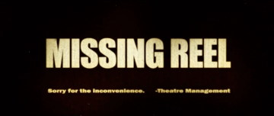
Flag Project
Computer issues are a pain…

Slide 8
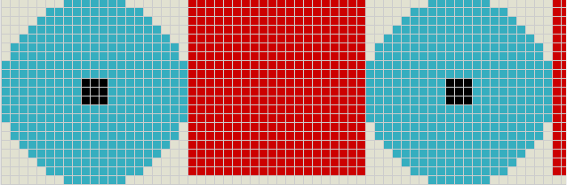
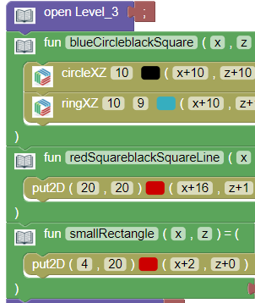
11_All_Functions
This was one of my first encounters with level 3 in bricklayer.
I decided a simple pattern in using all functions.
This particular code focuses on the main pattern which is the blue circle, black square and the red square.

Slide 9
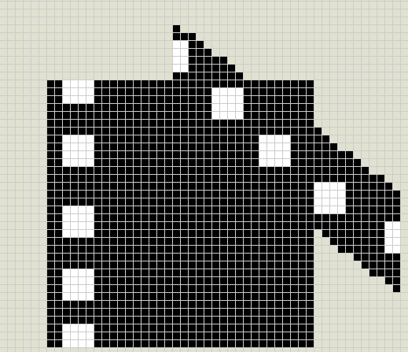
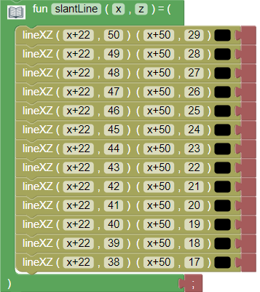

12_Real_Image
This was my attempt at the New Line Cinema logo.
The square was pretty basic and easy to figure out
The slant caused problems because I didn’t have a real solution on how to work the slant.

Slide 10
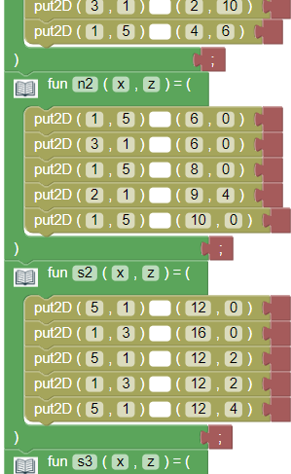
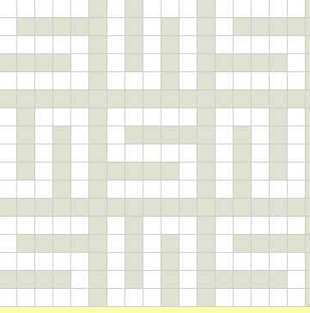
13_Space_Filling_Curves
Had a separate function for each shape
Each being labeled a different number to not lose track

